Slide 1
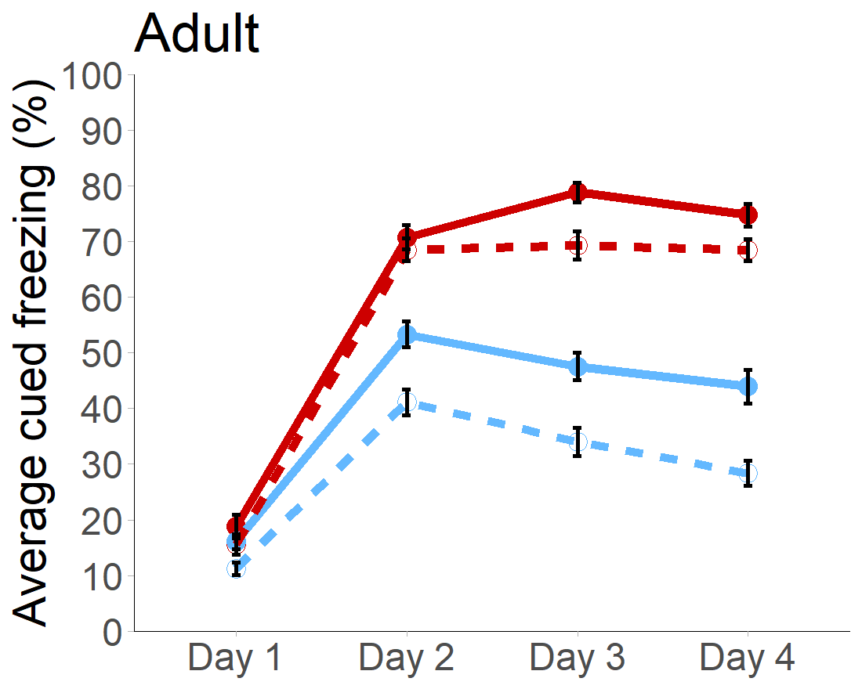
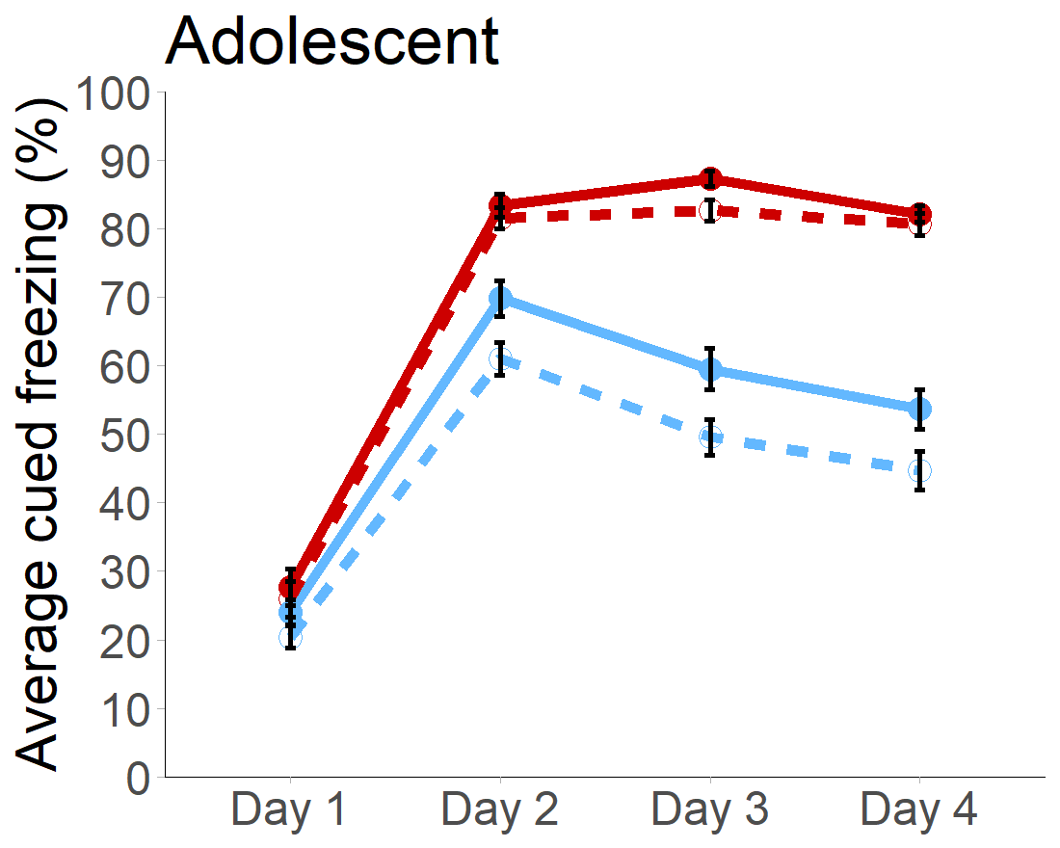

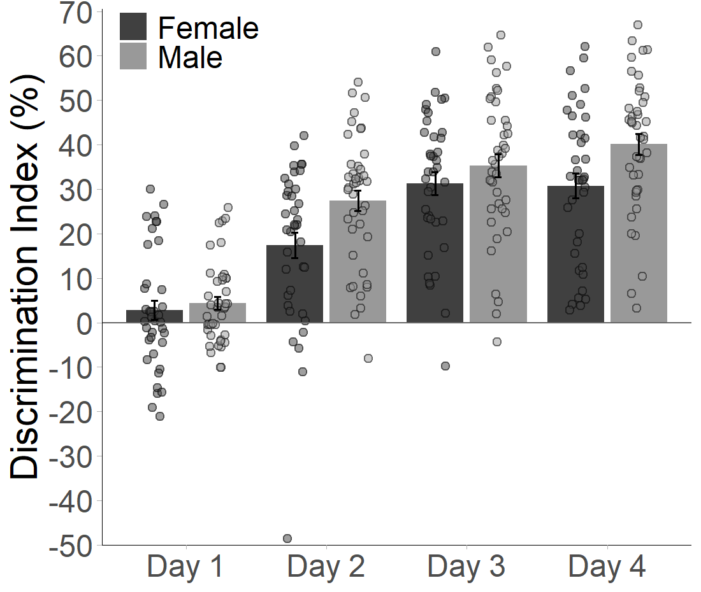
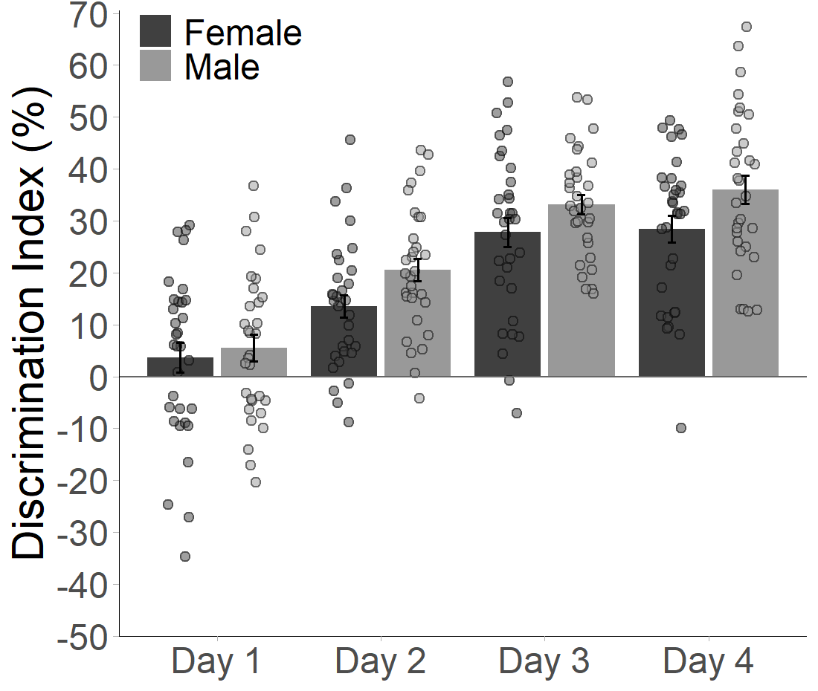
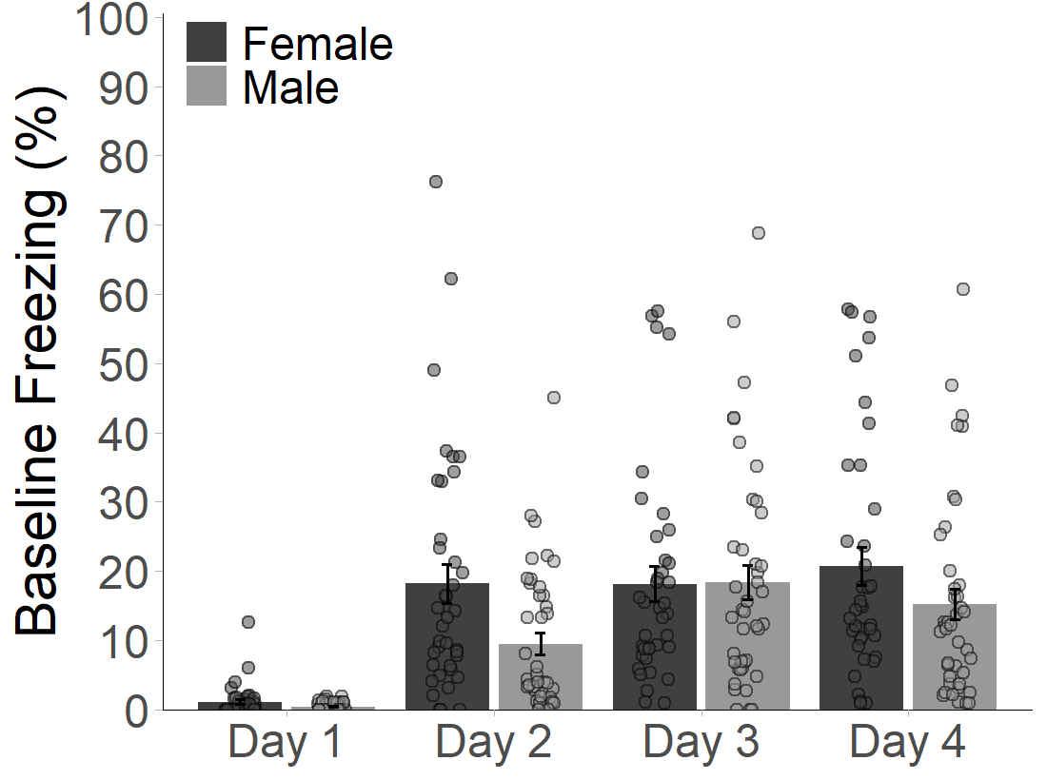
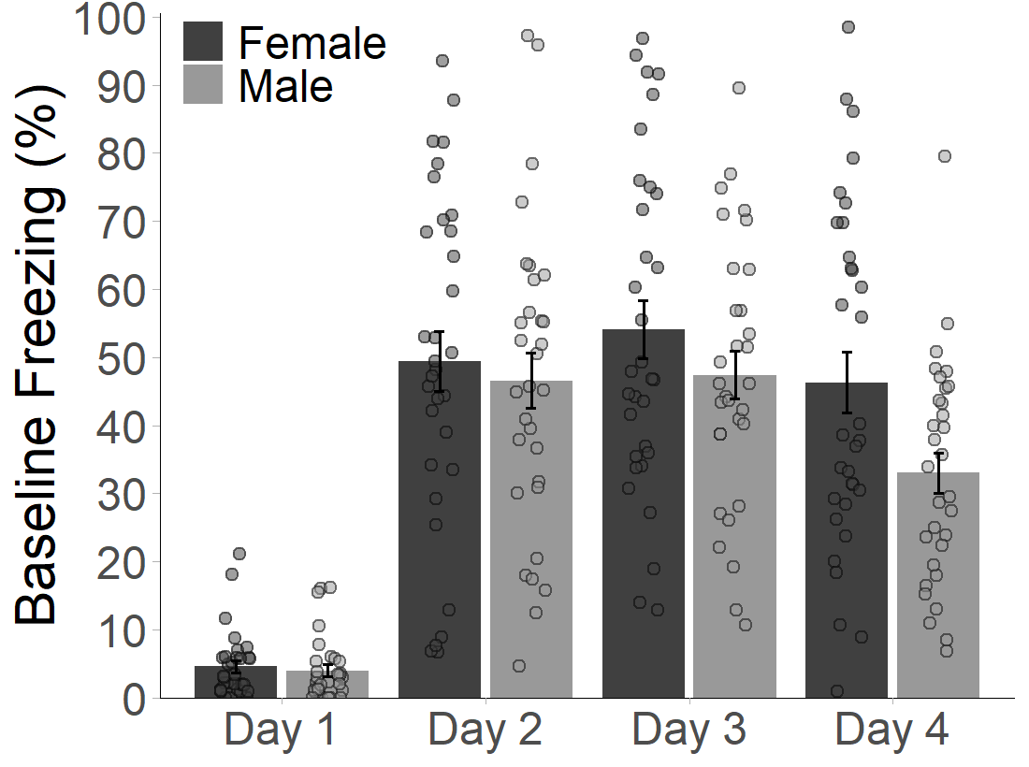
Female Fear
Male Fear
Female Safety
Male Safety
Add asterisks to graphs

Slide 2
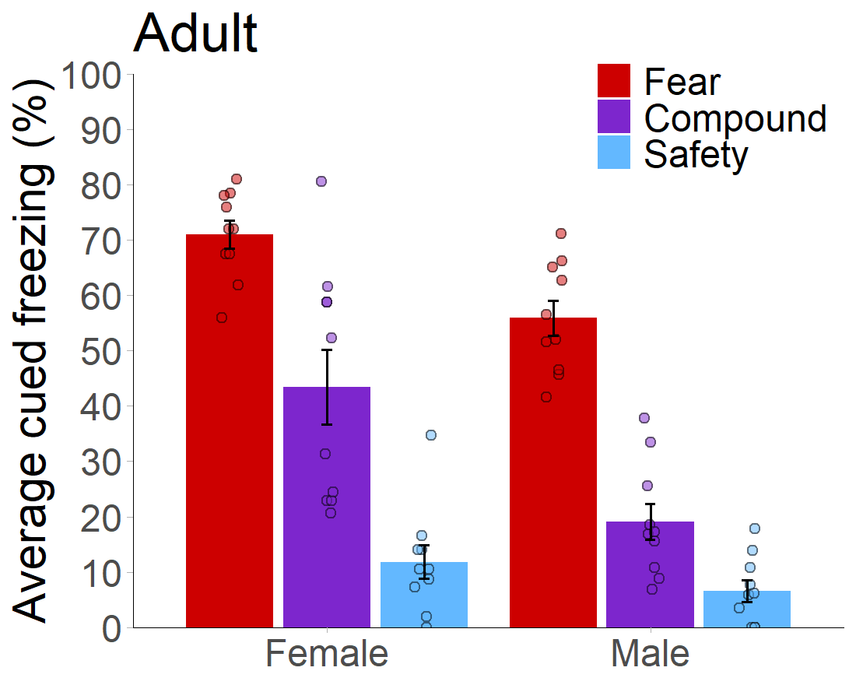
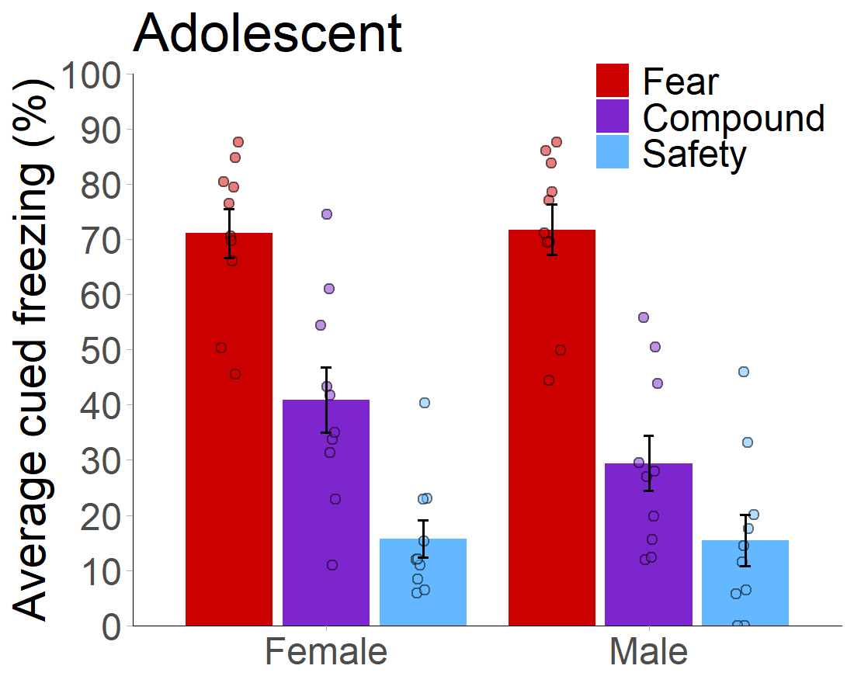
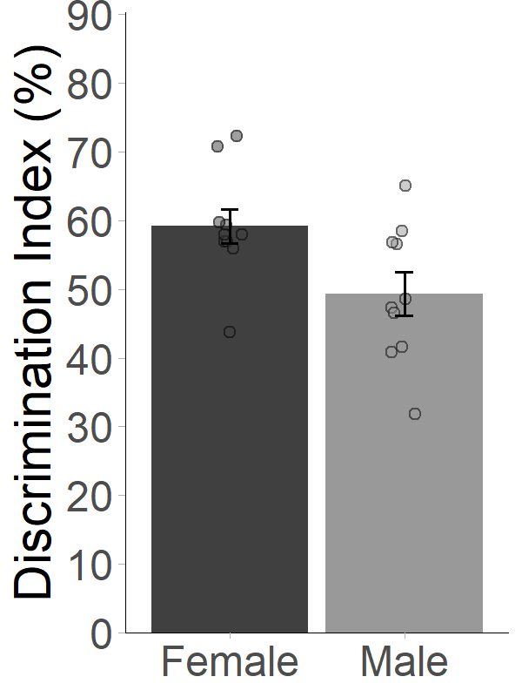
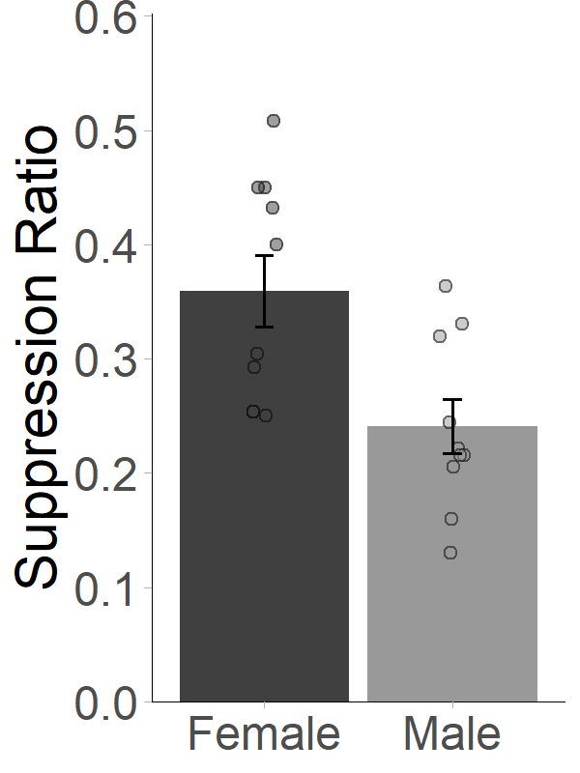
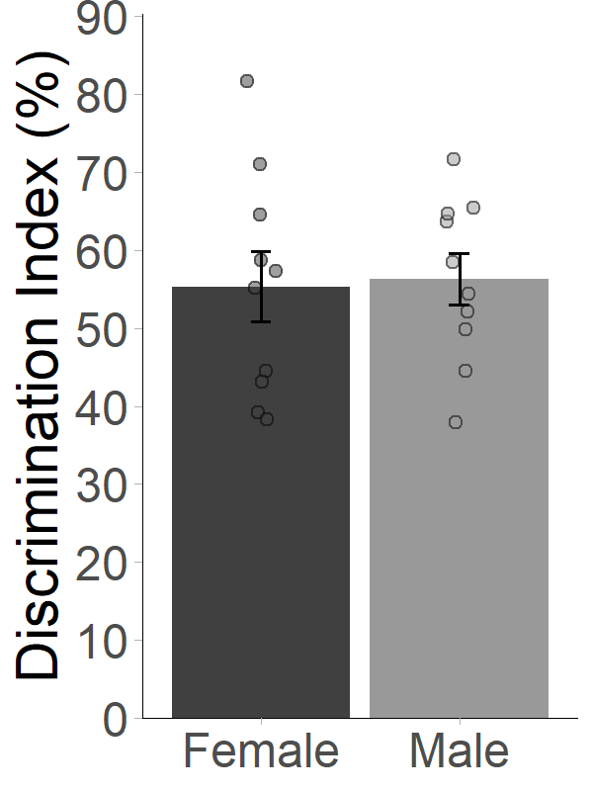
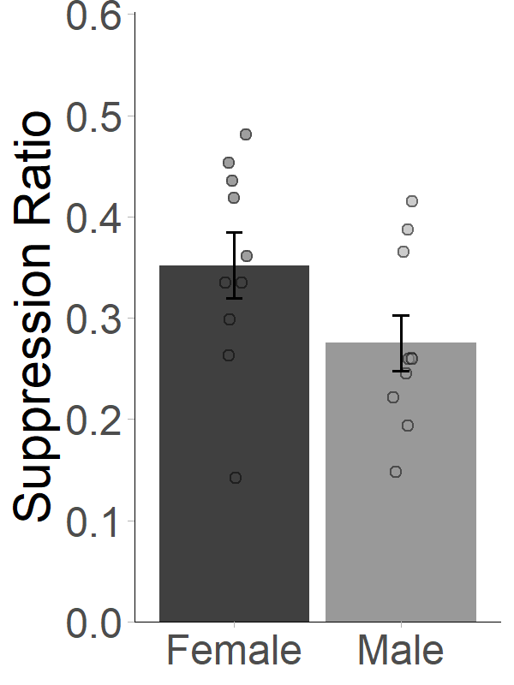

Slide 3
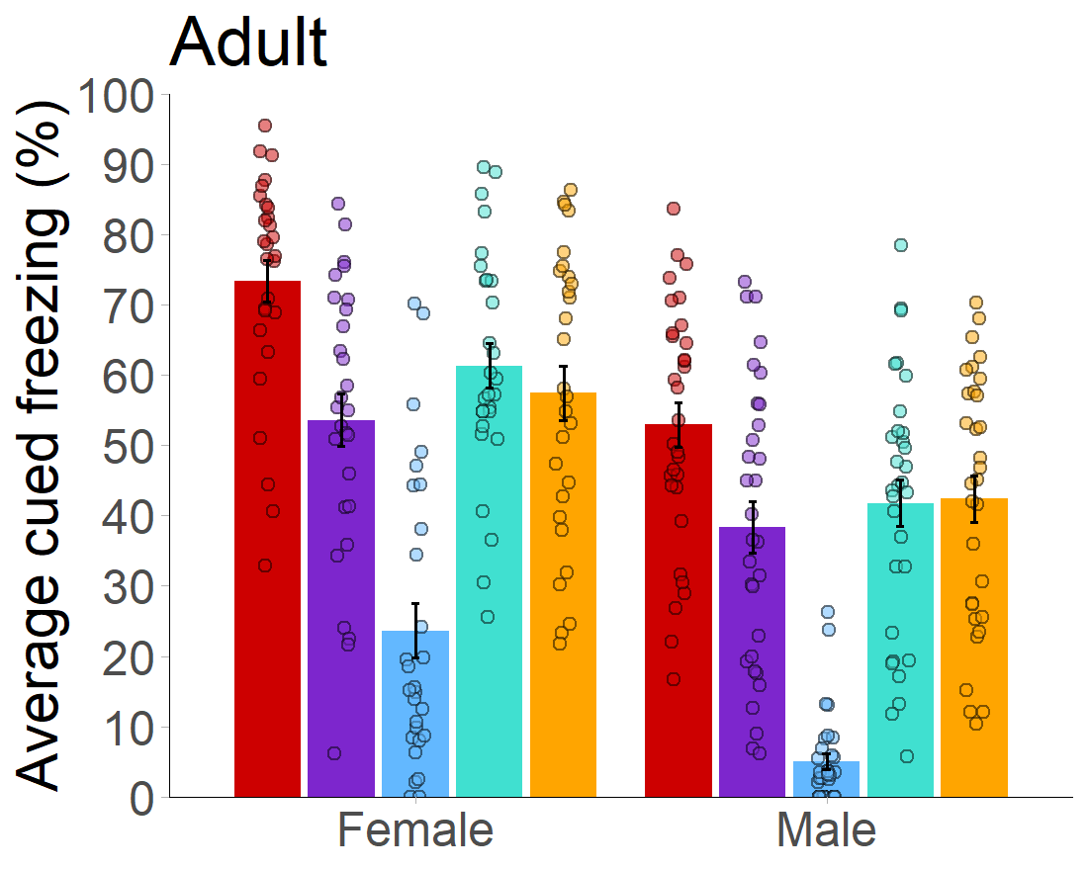
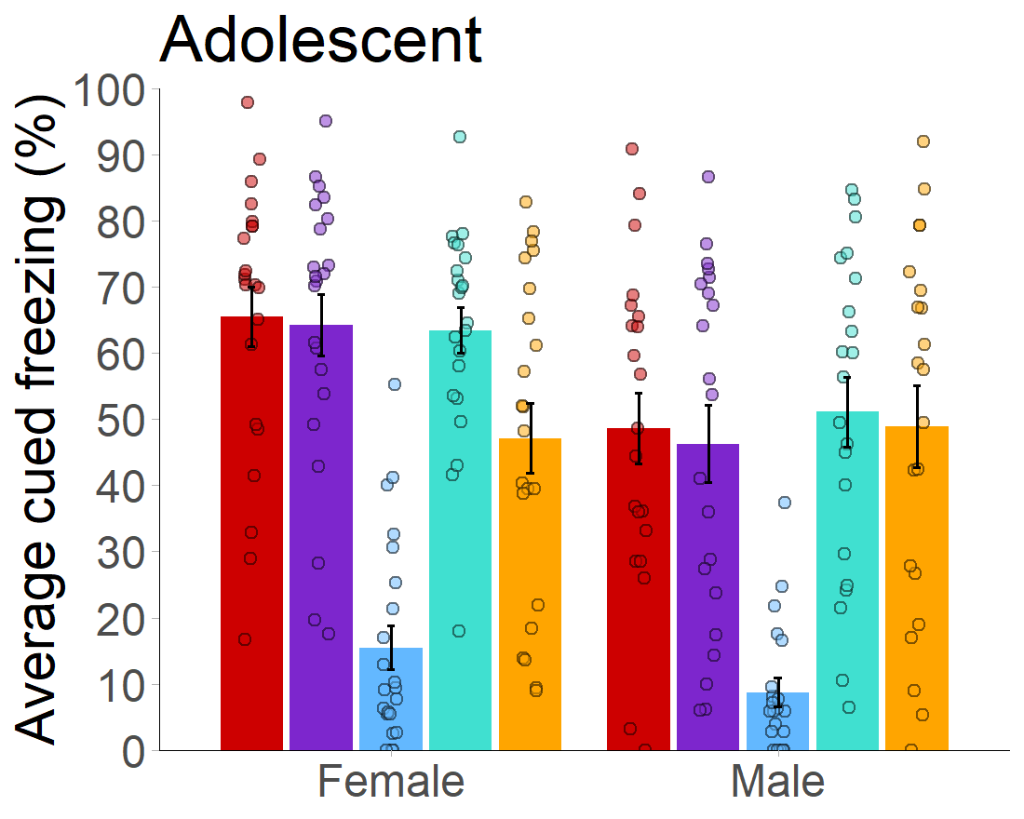
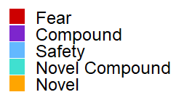

Slide 4
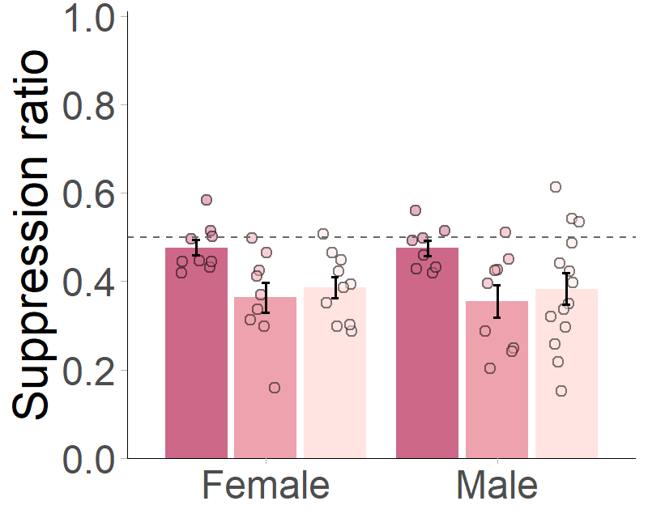
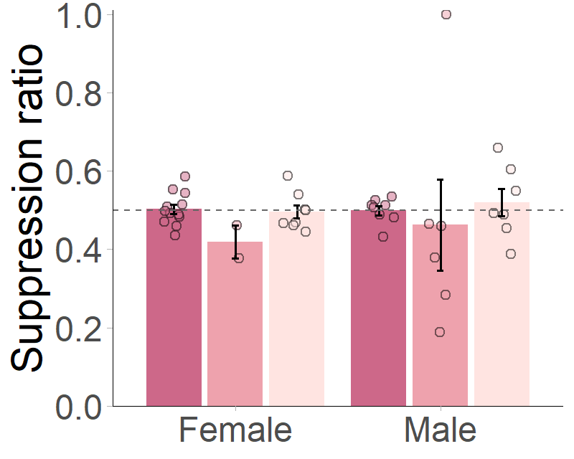
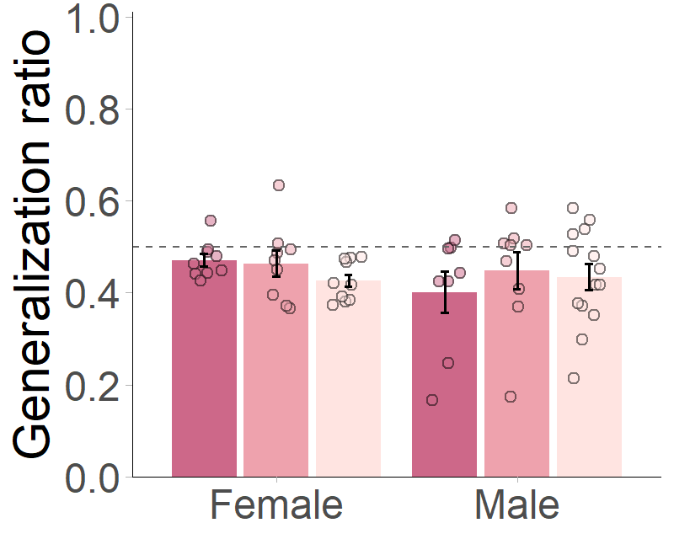
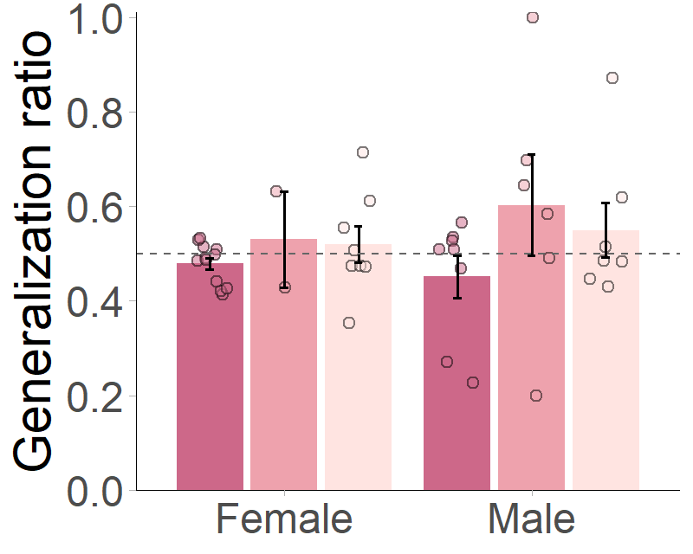
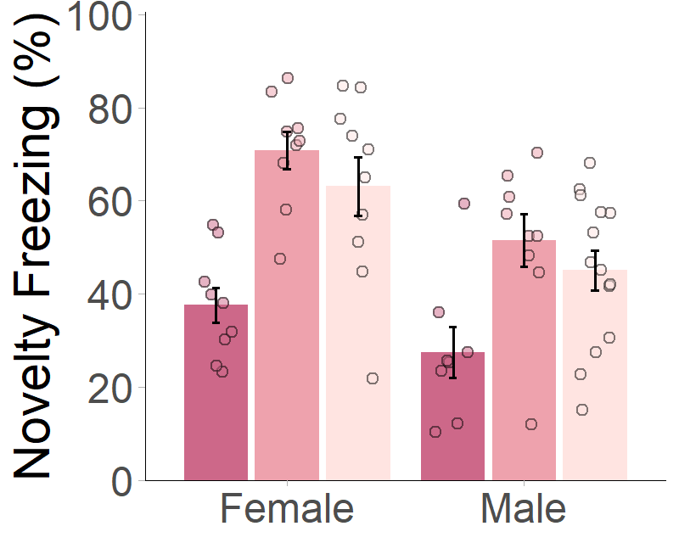
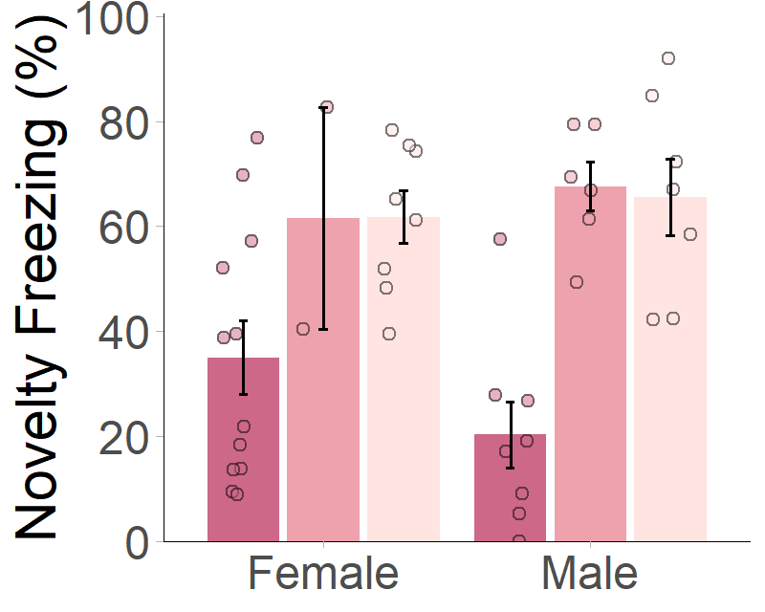
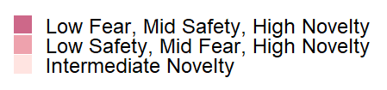
Schematic of what these conditions are, including relative khz values

Slide 5
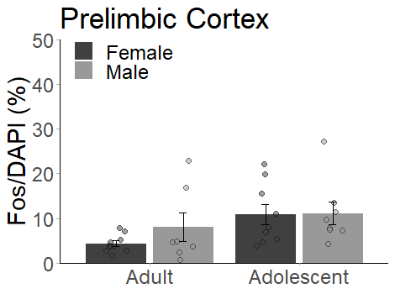
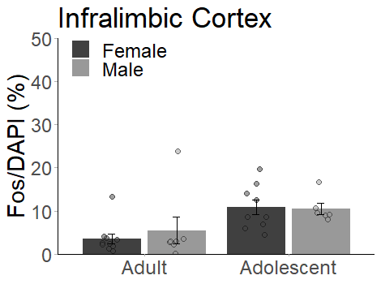
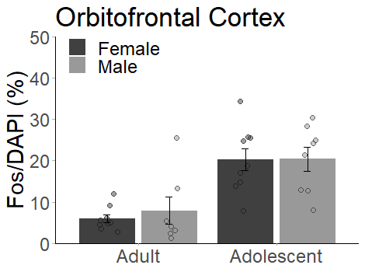
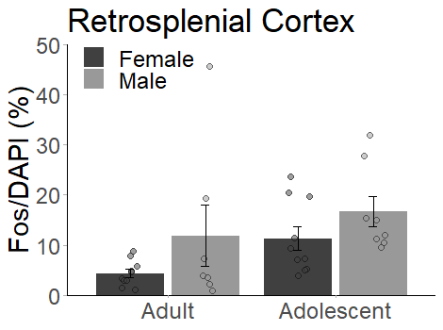
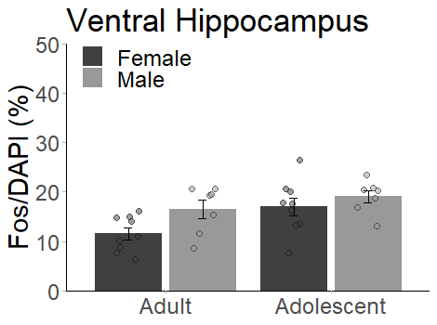
Add asterisks to graphs
RSC | P-value | coefficient
Fear | 0.02724138 | -0.15
Compound | 0.06716722 | -0.16
Safety | 0.70557971 | 0.02
Discrim | 0.20147652 | -0.2
Suppression | 0.18107211 | -0.1
Prelimbic | P-value | coefficient
Fear | 0.05941994 | -0.01
Compound | 0.14825348 | -0.01
Safety | 0.52129156 | -0.01
Discrim | 0.55483206 | 0.00
Suppression | 0.32655021 | 0.04
VH | P-value | coefficient
Fear | 0.14129806 | -0.09
Compound | 0.03385764 | -0.28
Safety | 0.81024313 | 0.19
Discrim | 0.14681712 | -0.3
Suppression | 0.05512859 | -0.34
Infralimbic | P-value | coefficient
Fear | 0.06259755 | 0
Compound | 0.17663502 | 0.02
Safety | 0.73307826 | 0.23
Discrim | 0.08224390 | -0.22
Suppression | 0.34380440 | 0.06
OFC | P-value | coefficient
Fear | 0.24293775 | 0.13
Compound | 0.09551632 | -0.02
Safety | 0.86657764 | 0.23
Discrim | 0.32971542 | -0.07
Suppression | 0.15077154 | -0.07

